Slide 1
.NET
Application Security
And
Permissions
August 30, 2017
Presenter:
Shashikant Tamhankar
Sr. Technical Lead

Slide 2
Agenda
Threats, Vulnerabilities, and Attacks
Security Defined
Application Security
  Threats
  Vulnerabilities/Scenarios
  Holistic approach to security/Foundation of security
Security in the .NET Framework
  Key Security Concepts
  Role-Based Security
  Code Access Security
Tools

Slide 3
The Basics

Slide 4
Threats, Vulnerabilities and Attacks
A threat is any potential and possibly malicious occurrence that could harm an asset. (A threat is any bad thing that can happen to your assets)
A vulnerability is a weakness that makes a threat possible. (This may be because of poor design, configuration mistakes, or inappropriate and insecure coding techniques.)
An attack is an action that exploits a vulnerability or enacts a threat.
A threat is a potential event that can adversely affect an asset, whereas a successful attack exploits vulnerabilities in your system.

Slide 5
Security Defined
Security is fundamentally about protecting assets.
As you analyze your infrastructure,
you identify potential threats.
Security is a path, not a destination.
Identify degree of risk presented by each threat.
Security is about risk management and implementing effective countermeasures.

Slide 6
Application Security

Slide 7






Application Security - Threats

Slide 8
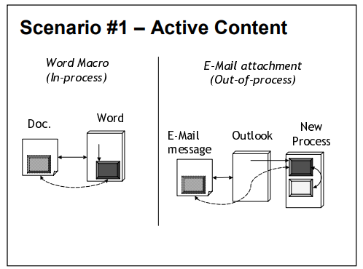
Application Security - Scenarios

Slide 9
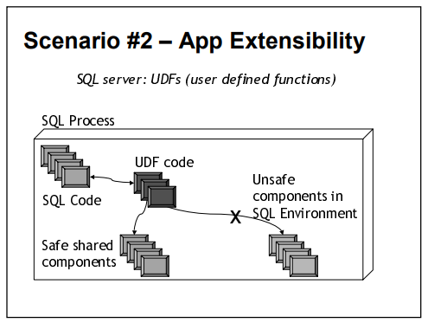
Application Security - Scenarios

Slide 10
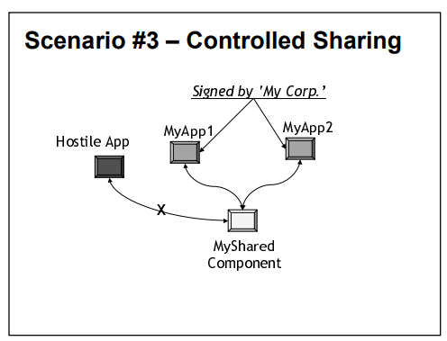
Application Security - Scenarios

Slide 11
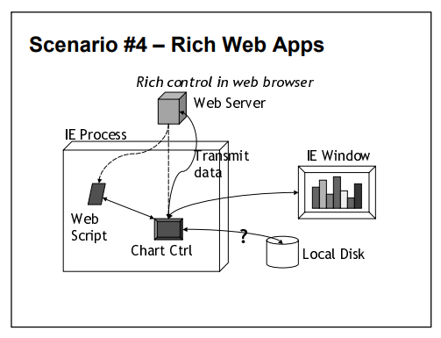
Application Security - Scenarios

Slide 12
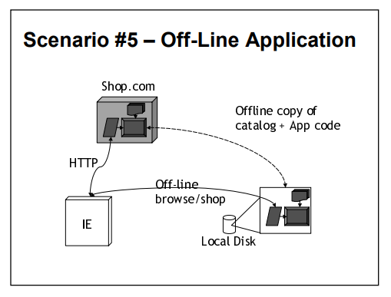
Application Security - Scenarios

Slide 13
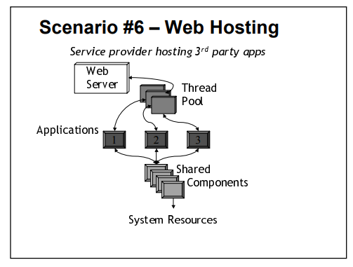
Application Security - Scenarios

Slide 14
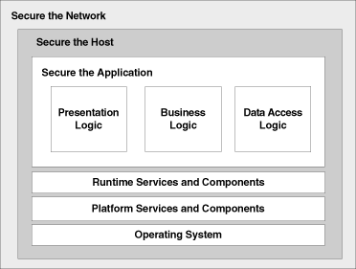
A holistic approach to security
Network Administrator
System Administrator
Developer

Slide 15
Foundation of Security
Security relies on the following elements:
Authentication ( who are you?)
  It is the process of uniquely identifying the clients of your applications and services. These might be end users, other services, processes, or computers. And then check the validity of that identity.
Authorization (what can you do?)
  It is the process that governs the resources and operations that the authenticated client is permitted to access. Check to see if the user can access particular resource or not.
Auditing
  Keep track of sensitive transactions in the application.

Slide 16
Foundation of Security
Security relies on the following elements:
Confidentiality/privacy
  The process of making sure that data remains private and confidential, and that it cannot be viewed by unauthorized users.(e.g. Encryption)
Integrity
  Integrity is the guarantee that data is protected from accidental or deliberate modification. (e.g. Integrity for data in transit is typically provided by using hashing techniques and message authentication codes.)
Availability
  Availability means that systems remain available for legitimate users. The goal for many attackers with “denial of service attacks” is other users cannot access the application.

Slide 17
.NET Framework Security Model

Slide 18
Security in the .NET Framework
.NET Framework Security Model
The .NET Framework provides several mechanisms for protecting resources and code from unauthorized code and users.
ASP.NET Web Application Security
  Provides a way to help limit access to a site by comparing authenticated credentials to file system permissions or to an XML file that lists authorized users, authorized roles, or authorized HTTP verbs.
Role-based security
  Provides information needed to make decisions about what a user is allowed to do. These decisions can be based on either the user's identity or role membership, or both.
Code access security
  Uses permissions to help limit the access that code has to protected resources and operations. It helps protect computer systems from malicious mobile code and helps provide a way to allow mobile code to run safely. (Code access security, together with the policies that govern it, are referred to as evidence-based security.)

Slide 19
Role Based Security

Slide 20
Role Based Security
This security is all about who is the user and what this user can do.
Authentication and Authorization are 2 major security practices.
Authentication is the part of verifying user’s identity.
Authorization is determining whether or not a user has the permission to perform an action in the application.
Authorization relies on knowing the identity of the user and being able to find the security information associated with that user. Based on the security information, the application then can grant or deny permissions.
.NET Framework role-based security supports authorization by making information about the principal, which is constructed from an associated identity.

Slide 21
Role Based Security
Identity Objects
The identity object encapsulates information about the user or entity being validated.
At their most basic level, identity objects contain a name and an authentication type.
The name can either be a user's name or the name of a Windows account.
The authentication type can be either a supported logon protocol, such as NTLM, Kerberos V5, or a custom value.

Slide 22
Role Based Security
Principal Objects
A principal represents the identity and role of a user.
Role-based security in the .NET Framework supports three kinds of principals:
Generic principals represent users and roles that exist independent of Windows users and roles.
Windows principals represent Windows users and their roles .
Custom principals can be defined by an application in any way that is needed for that particular application.

Slide 23
Role Based Security
Demo

Slide 24
Code Access Security (CAS)

Slide 25
Code Access Security (CAS)
Code Access Security enables users to restrict what managed code can do according to a level of trust.
If the CLR trusts the code enough to allow it to run then it will begin executing the code depending on the permissions given to the assembly.
If the code is not trusted and attempts to perform some action it does not have relevant rights for then a security exception is thrown.

Slide 26
Code Access Security (CAS)
The Common Language Runtime (CLR) allows code to perform only those operations that the code has permission to perform.
So CAS is the CLR's security system that enforces security policies by preventing unauthorized access to protected resources and operations.
Using the Code Access Security, you can do the following:
  Restrict what your code can do
  Restrict which code can call your code
  Identify code

Slide 27
Code Access Security (CAS)
Components Of Code Access Security
CAS
Permission
Code Groups
Permission Set

Slide 28
Code Access Security (CAS)
Components Of Code Access Security
CAS
Permission
Code Groups
Permission Set
Permissions represent access to a protected resource or the ability to perform a protected operation. The .NET Framework provides several permission classes, like FileIOPermission (when working with files), UIPermission (permission to use a user interface), etc.

Slide 29
Code Access Security (CAS)
Components Of Code Access Security
CAS
Permission
Code Groups
Permission Set
A permission set is a collection of permissions. A permission set can include any number of permissions. FullTrust, LocalIntranet, Internet, Execution and Nothing are some of the built in permission sets in .NET Framework. FullTrust has all the permissions in the world, while Nothing has no permissions at all, not even the right to execute. You can put FileIOPermission and UIPermission into your own permission set and call it "My_PermissionSet".

Slide 30
Code Access Security (CAS)
Components Of Code Access Security
CAS
Permission
Code Groups
Permission Set
Code group is a logical grouping of code that has a specified condition for membership. Code from http://www.somewebsite.com/ can belong to one code group, code containing a specific strong name can belong to another code group and code from a specific assembly can belong to another code group. There are built-in code groups like My_Computer_Zone, LocalIntranet_Zone, Internet_Zone etc. Like permission sets, we can create code groups to meet our requirements based on the evidence provided by .NET Framework. Site, Strong Name, Zone, URL are some of the types of evidence.

Slide 31
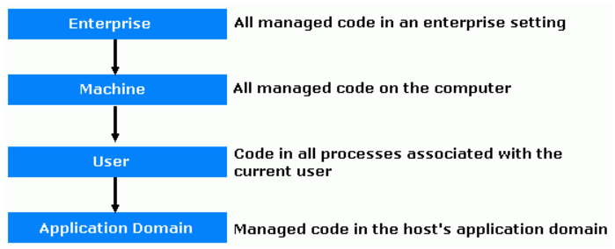
Code Access Security (CAS)
Components Of Code Access Security - Policy
Security policy is the configurable set of rules that the CLR follows when determining the permissions to grant to code.
There are four policy levels which has its own code groups and permission sets.

Slide 32
Code Access Security (CAS)
Demo

Slide 33
Code Access Security (CAS)
Imperative and declarative syntax: Interaction with the runtime security system is performed using imperative and declarative security calls. Declarative calls are performed using attributes; imperative calls are performed using new instances of classes within your code. Some calls can be performed only imperatively, while others can be performed only declaratively. Some calls can be performed in either manner.
Is applied using security permission attributes.
Attribute syntax is used.
The security constraints are stored in the assembly at compile time.
Is applied by using calls to permission classes.
The attribute syntax is not used.
It is implemented by writing the regular code to provide restrictions.
Declarative
Imperative

Slide 34
Code Access Security (CAS)
Declarative Security
This is accomplished by placing security attributes at the assembly level, class level or member level.
The attribute indicates the request type, overrides and demands.
Each permission object has a state data, and this needs to be initialized to use that permission.
Also, each permission has an attribute to which the type of security action, which is an enumeration called SecurityAction, is passed to the attribute.

Slide 35
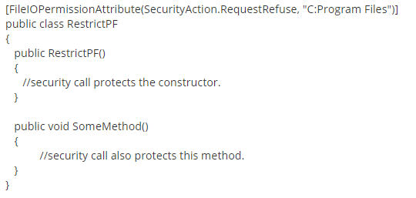
Code Access Security (CAS)
Declarative Security
All the members of the class are restricted accessing the "Program Files" folder.

Slide 36
Code Access Security (CAS)
Declarative Security
All the members of the assembly are restricted accessing the "Program Files" folder.
All the members of the assembly are restricted accessing registry.
With this code, even though the code runs in an environment that allows access to the registry or perform FileIO operations, the assembly will not be granted any kind of permissions.
The disadvantage of declarative security is that there are tools which extract security requirements from the metadata in the assembly.

Slide 37
Code Access Security (CAS)
Imperative Security
A new instance of the security permission object needs to be created before calling. Also, one need to initialize the permission set to invoke a security object. A permission set consists of a group of permissions; initializing a permission group provides a means to perform assert calls on multiple permissions in one method.
This helps in situations where you want to check the permissions at runtime.
You can use imperative syntax to perform demands and overrides, but not requests.

Slide 38
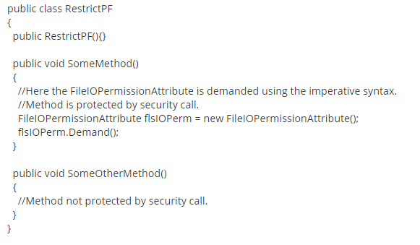

Code Access Security (CAS)
Imperative Security

Slide 39
Code Access Security (CAS)
Demo

Slide 40
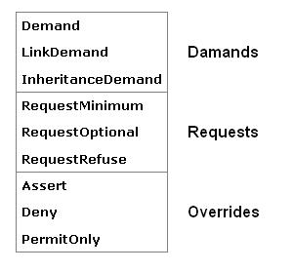
Code Access Security (CAS)
Security Actions
Demand - Demands are used to ensure that every caller who calls your code has been granted the demanded permission.
Request – Requests specify the permissions your code must/can/should not have in order to run; prior to loading the assembly.
Overrides - override certain security checks.

Slide 41
Functions of Code Access Security (CAS)
Defines permissions and permission sets that represent the right to access various system resources.
Enables administrators to configure security policy by associating sets of permissions with groups of code (code groups).
Enables code to request the permissions it requires in order to run, as well as the permissions that would be useful to have, and specifies which permissions the code must never have.
Grants permissions to each assembly that is loaded, based on the permissions requested by the code and on the operations permitted by security policy.
Enables code to demand that its callers have specific permissions. Enables code to demand that its callers possess a digital signature, thus allowing only callers from a particular organization or site to call the protected code.
Enforces restrictions on code at run time by comparing the granted permissions of every caller on the call stack to the permissions that callers must have.

Slide 42
Code Access Security (CAS)
Some facts:
It is not primarily a tool for protecting software from users.
Can be applied only to managed applications. Unmanaged applications run without any CAS restrictions and are limited only by the operating system's role-based security.
If CAS is used to restrict the permissions of an assembly then the assembly is considered partially trusted.
Partially trusted assemblies must undergo CAS permission checks each time they access a protected resource.
Fully trusted assemblies, like unmanaged code, can access any system resource that the user has permissions to access.

Slide 43
Code Access Security (CAS)
Some facts:
Because Security settings can change from computer to computer, you can never be sure that your code will receive sufficient permissions to run.
As a developer, you must understand how to create applications that work, even when some permission is restricted or to restrict your application from performing certain tasks.

Slide 44
Tools

Slide 45
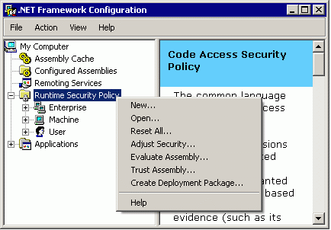
Tools - .NET Configuration Tool
Evaluate Assembly - This can be used to find out which code group(s) a particular assembly belongs to, or which permissions it has.
Create Deployment Package - This wizard will create a policy deployment package. Just choose the policy level and this wizard will wrap it into a Windows Installer Package (.msi file), so what ever the code groups and permissions in your development PC can be quickly transferred to any other machine without any headache.

Slide 46
Tools - Permissions View Tool - permview.exe
The Permissions View tool is used to view the minimal, optional, and refused permission sets requested by an assembly.
Optionally, you can use permview.exe to view all declarative security used by an assembly.
Examples:
permview SecurityApp.exe
Displays the permissions requested by the assembly SecurityApp.exe.

Slide 47
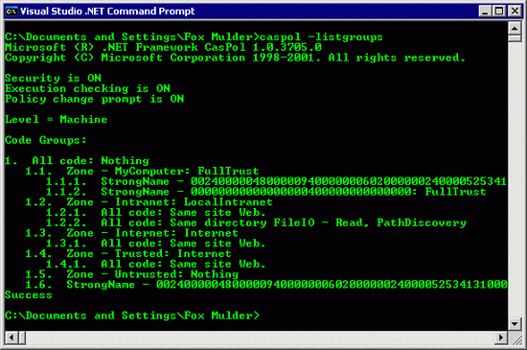
Tools - Code Access Security Policy Tool - caspol.exe
The Code Access Security Policy tool enables users and administrators to modify security policy for the machine policy level, the user policy level and the enterprise policy level.
Examples:
run "caspol -listgroups", this will list the code groups that belong to the default policy level - Machine level.

Slide 48


Thank You!
India
Mumbai
4th Floor, Nomura
Powai , Mumbai 400 076
Pune
5th Floor, Amar Paradigm
Baner, Pune 411 045
Kolkata
2B, 12th Floor, Tower ‘C’
Rajarhat, Kolkata 700 156
US – Corporate Headquarters
1248 Reamwood Avenue,
Sunnyvale, CA 94089
Phone: (408) 743 4400
343 Thornall St 720
Edison, NJ 08837
Phone: (732) 395 6900
UK
20 Broadwick Street
Soho, London
W1F 8HT, UK
89 Worship Street
Shoreditch,
London EC2A 2BF, UK
Phone: (44) 2079 938 955
Bangalore
4th Floor, Kabra Excelsior,
80 Feet Main Road, Koramangala 1st Block,
Bengaluru (Bangalore) 560034
Gurgaon
A/373rd Floor, Sigma Center
Gurgaon, Haryana 122 011s

Slide 49
Security is TOP focus
https://msdn.microsoft.com/en-us/library/z164t8hs(v=vs.90).aspx
http://www.c-sharpcorner.com/UploadFile/84c85b/net-code-access-security-cas/
https://www.codeproject.com/Articles/5724/Understanding-NET-Code-Access-Security
http://www.codeguru.com/csharp/csharp/cs_misc/security/article.php/c7415/Introduction-to-RoleBased-Security-in-NET.htm

